Slide 1

Seminar 1 - Time series data mining Philippe Esling, Carlos Agon
Group 4
-
Raphaël Humblet
Leon Molle
Yitong Li
April 2024 – IL2233 Embedded intelligence

Slide 2
Table of Contents
Introduction
Challenges
Tasks in time-series data mining
Implementation components
Research Trends and Issues
Conclusion

Slide 3
1. Introduction
Time series:
"represents a collection of values obtained from sequential measurements over time"
Data Mining:
"stems from desire to reify our natural ability to visualize shape of data"
complexity arises from high dimensionality of time series data

Slide 4
2. Challenges
Data Representation:
How can the fundamental shape characteristics of a time-series be represented?
Similarity Measurement
How can pairs of time-series be distinguished or matched?
Indexing Method
How should a massive set of time-series be organized to enable fast querying?

Slide 5
3. Tasks in Time-Series data mining
Query by content – Finding a set of solutions similar to a user query
Clustering – Finding natural groups/clusters in a dataset
Classification – Label each new series coming
Segmentation – Reducing dimensionality while retaining it essential features
Prediction – Forecast the next few values of a series
Anomaly detection – Find abnormal subsequences in a time series
Motif discovery – Finding every subsequence that appears recurrently in a series

Slide 6
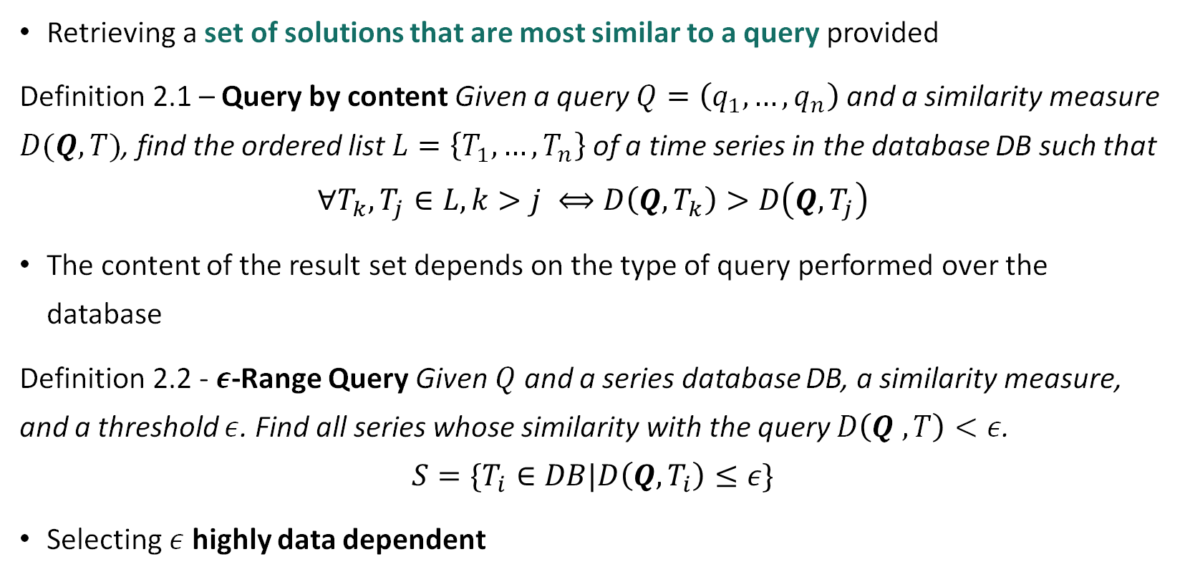
3. Query by content
Retrieving a set of solutions that are most similar to a query provided
Definition 2.1 – Query by content Given a query $Q=\left(q_{1},…,q_{n}\right)$ and a similarity measure $D(Q, T)$, find the ordered list $L=\left\{T_{1},…,T_{n}\right\}$ of a time series in the database DB such that
$$∀T_{k},T_{j}∈L, k>j ⟺D\left(Q, T_{k}\right)>D\left(Q, T_{j}\right)$$
The content of the result set depends on the type of query performed over the database
Definition 2.2 - $ε$-Range Query Given $Q$ and a series database DB, a similarity measure, and a threshold $ε$. Find all series whose similarity with the query $D\left(Q , T\right)<ε$.
$$S=\{T_{i}∈DB|D\left(Q,T_{i}\right)≤ε\}$$
Selecting $ε$ highly data dependent

Slide 7
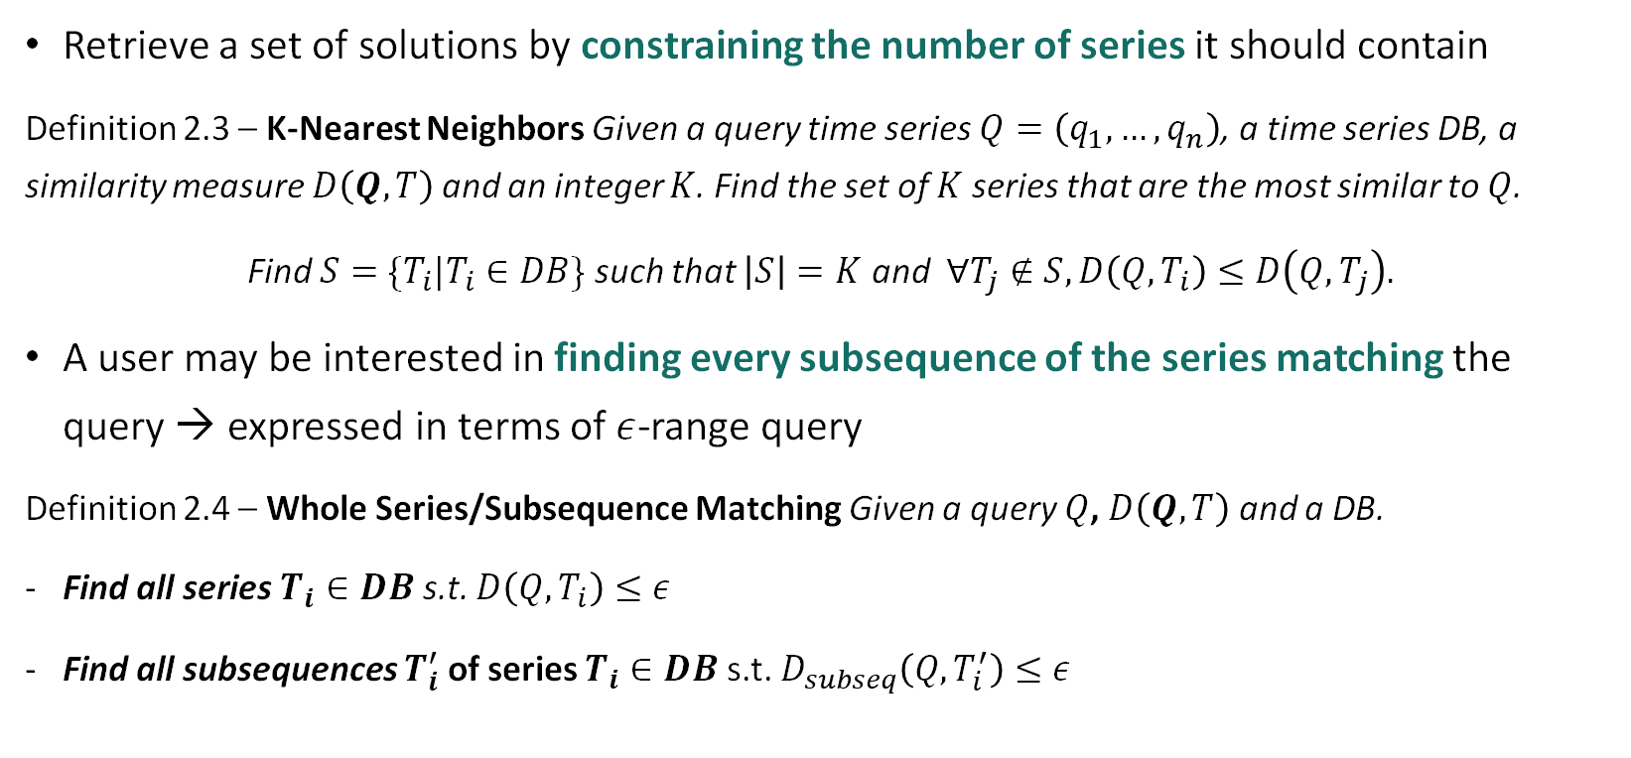
3. Query by content
Retrieve a set of solutions by constraining the number of series it should contain
Definition 2.3 – K-Nearest Neighbors Given a query time series $Q=\left(q_{1},…,q_{n}\right)$, a time series DB, a similarity measure $D\left(Q, T\right)$and an integer $K$. Find the set of $K$ series that are the most similar to $Q$.
Find $S=\{T_{i}|T_{i}∈DB\}$ such that $\left|S\right|=K$ and $∀T_{j}∉S, D\left(Q,T_{i}\right)≤D\left(Q, T_{j}\right).$
A user may be interested in finding every subsequence of the series matching the query → expressed in terms of $ε$-range query
Definition 2.4 – Whole Series/Subsequence Matching Given a query $Q$, $D\left(Q, T\right)$ and a DB.
Find all series $T_{i}∈DB$ s.t. $D\left(Q, T_{i}\right)≤ε$
Find all subsequences $T_{i}^{′}$ of series $T_{i}∈DB$s.t. $D_{subseq}\left(Q,T_{i}^{′}\right)≤ε$

Slide 8
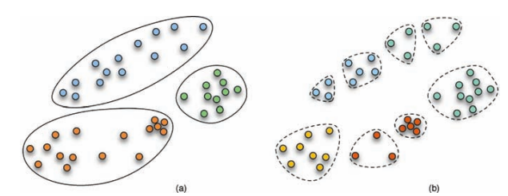
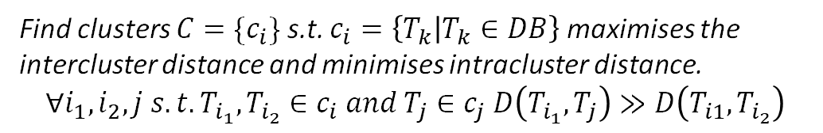
3. Clustering
Clustering - Finding natural groups/clusters in a dataset
→ Useful for data streams
Implemented by using AR models, k-means and k-center-clustering
Subsequence clustering - same but cluster of subsequences only
Width of subsequence thanks to investigating the periodical structure by using DFT analysis
If nonoverlapping slicing → may miss important structures
Overlapping may also lead to meaningless results!
Find clusters $C=\{c_{i}\}$ s.t. $c_{i}=\left\{T_{k} | T_{k}∈DB\right\}$ maximises the intercluster distance and minimises intracluster distance.
$$∀i_{1},i_{2},j s.t.T_{i_{1}},T_{i_{2}}∈c_{i} and T_{j}∈c_{j} D\left(T_{i_{1}},T_{j}\right)≫D\left(T_{i1},T_{i_{2}}\right)$$
Depend on an arbitrary number of cluster N=3 (a), N=8 (b)
➔ Clustering is used a lot for DNA analysis

Slide 9
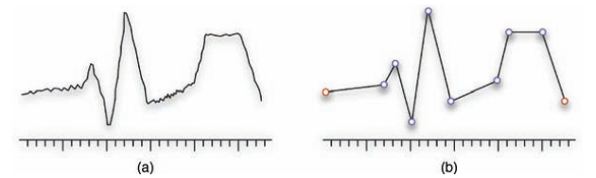
3. Classification and segmentation
Classification - Label each new series coming
Different methods tried - 1NN-DTW, ARMA, HMM, …
Main challenge: High dimensionality requires high computation power
Need to avoid overtraining to avoid overfitting → performance of the model decreases
Interest for computer interface based on EEG signals
Segmentation - reducing dimensionality while retaining essential features

Slide 10
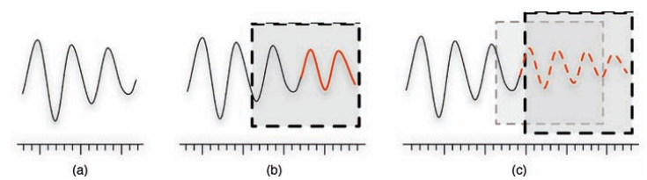
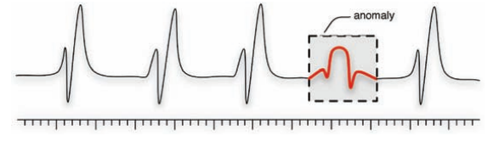
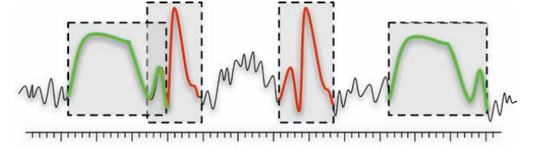
Prediction – Forecast the next few values of a series
Anomaly detection – Find abnormal subsequences in a time series
Motif discovery – Finding every subsequence that appears recurrently in a series

Slide 11
4. Implementation Components
Representation methods - Low-dimensional representations
Similarity measures - Exhibit relevant aspects of the similarity
Indexing techniques - Efficiently manage and query ever growing massive datasets.

Slide 12
Preprocessing
Noise and outliers
Digital filters
Wavelet thresholding
Independent Component Analysis(ICA)
Scaling differences
A linear transformation of the amplitudes
Series length
Resampling

Slide 13
Representation
Requirements
significant reduction of the data dimensionality;
emphasis on fundamental shape characteristics on both local and global scales;
low computational cost for computing the representation;
good reconstruction quality from the reduced representation;
insensitivity to noise or implicit noise handling.

Slide 14
Representation
Nondata Adaptive
The parameters of the transformation remain the same for every time series regardless of its nature.
Data Adaptive
The parameters of a transformation are modified depending on the data available.
Model Based
Series observed has been produced by an underlying model.

Slide 15
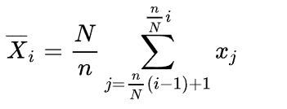
Nondata Adaptive
Discrete Fourier transform: Projects the time series on a sine and cosine functions basis
Discrete wavelet transform: Scaled and shifted versions of a mother wavelet function. Better time resolution in the high frequency , better frequency resolution in the low frequency.
Discrete Cosine Transform: Only on cosine basis
Piecewise Aggregate Approximation: Divide the original data into N segments of equal length, and calculate the mean value within each segment to obtain the dimensionally reduced data representation.
Multiresolution PAA: Including a multiresolution property

Slide 16
Similarity Measure
Notion of similarity between series, based on the more intuitive notion of shape.
In the case of very large datasets, Euclidean distance has been shown sufficient, Otherwise:
(1) It should provide a recognition of perceptually similar objects, even though they are not mathematically identical.
(2) It should be consistent with human intuition.
(3) It should emphasize the most salient features on both local and global scales.
(4) A similarity measure should be universal in the sense that it allows to identify or distinguish arbitrary objects, that is, no restrictions on time series are assumed.
(5) It should abstract from distortions and be invariant to a set of transformations.

Slide 17
Similarity Measure
Shape Based
Edit Based
Feature Based
Structure Based
Comparison of Distance Measures

Slide 18
Indexing
An indexing scheme allows to have an efficient organization of data for quick retrieval in large databases.
(1) It should be much faster than sequential scanning.
(2) The method should require little space overhead.
(3) The method should be able to handle queries of various lengths. Comparison of Distance Measures.
(4) The method should allow insertions and deletions without rebuilding the index.
(5) It should be correct, that is, there should be no false dismissals.

Slide 19
5. Research Trends and Issues: Embedded Systems
Memory:
Limited memory space
No permanent access
Sensor networks:
Use huge amounts of streaming data
Need to design space efficient techniques
Proposed Solution: "Autocannibalistic" Algorithm by Ye et al. (2009)

Slide 20
5. Research Trends and Issues: Stream analysis
Streams:
Continuously generated measurements
Analyzing such data flows are computationally extreme tasks
Apache Flink (2015):
Co-developed by KTH
Allows analyzing, transform and calculation on streaming data in real time

Slide 21
6. Conclusion
Time-series data mining is difficult task
We presented different ways to approach data mining
For every task in time series analyzing similarity measure and indexing will have a big impact on result
Important to make conscious decisions about which approach to choose, is its dependent on the data
still open issues and ongoing research

Slide 22
Questions for A1
Low-dimensional representations is an important part in both papers, what methods are mentioned in your paper and what's the main idea? For example, PAA?
What is the purpose of preprocessing for time series data mining?
Where does time series data mining can be applied and what for?
Edit function is to edit the time series or the database?

